Slide 1
Project 1
Summary and Findings
Abou Keita and William Simpson
DATA 690 - Practical Deep Learning
12 October 2022

Slide 2
Using Neural Networks for Tabular Data
Significance: Neural Networks (NNs) excel on computer vision & NLP tasks, but there seems to be a fairly persistent gap in their performance on tabular data
Project Structure
Literature Review
Model Building
Understand the performance gap between tree-based models and neural networks on tabular data
Explore the reasons for this performance gap in existing research
Conduct our own comparison of tree vs. NN performance on tabular data

Slide 3
Background Literature
Reasons for the performance gap
Other Factors
How the data is processed impacts model performance
03
Properties of the Data
Tabular data exhibits different characteristics from image or text data
01
02
Properties of the Model
Machine learning and Deep learning models make implicit and explicit assumptions

Slide 4
Background Literature
Properties of the Data
Heterogeneous features¹
Uninformative features²
Importance of single features¹
Quality of training data¹
No (or irregular) dependencies between features in tabular data¹
Amount of data³
1: Borisov et al., 2021; 2: Grinsztajn, Oyallon, & Varoquaux, 2022; 3: Klambauer, Unterthiner, & Mayr, 2017

Slide 5
Background Literature
Properties of the Model
Non-linearity and high complexity¹
NNs biased to produce excessively smooth solutions²
NN learning procedure is invariant by rotation²
Other Factors
Specific preprocessing steps¹
1: Borisov et al., 2021; 2: Grinsztajn, Oyallon, & Varoquaux, 2022

Slide 6
Background Literature
Proposed Strategies for using NNs with tabular data
Data Transformations
Single and Multi Dimensional Feature Encodings^{1, 4}
Specialized Architectures
Hybrid Tree-NN Models and Transformer-based Models^{1,5}
Regularization
Specialized Loss Functions^{1, 5}
1: Borisov et al., 2021; 4: Hancock & Khoshgoftaar, 2020, 5: Shwartz-Ziv & Armon, 2022

Slide 7
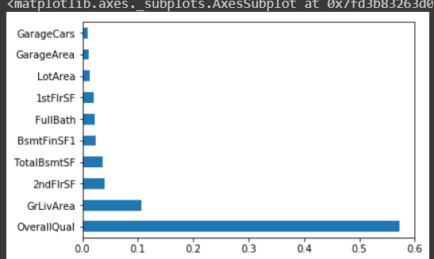
Results: Random Forest
R2 Coefficient of Determination: 0.88
Training and testing loss values
Mean Average Error: : 17768.99419863014
Mean Square Error: 796715344.6813024
Root Mean Square Error : : 28226.146472398643
^{VarScore: 0.8789873188356354}
Tuning Parameters
Utilized 1000 decision trees as our n_estimator
Default parameters: criterion=’gini’, no weights or max_depth
The reason being we wanted to have a good baseline for a simple RF and simple NN

Slide 8
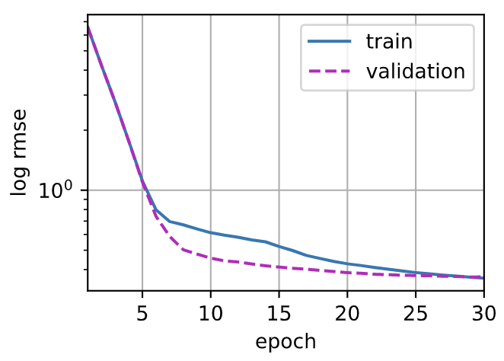
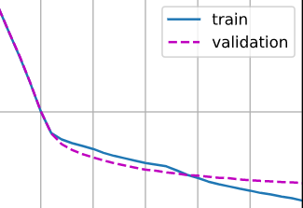
Results: Neural Network
R2 Coefficient of Determination: 0.75
Transformed all training and testing variable from numpy to tensor
num_epochs = 30
learning_rate = .01
weight_decay = 0
batch_size = 64
Loss function = MSE
Input: X_train, shape: 331 input
Activation Function: ReLU
Optimization: Adam
Hidden Layers: 100 , 50
Output layer: 1
Hyperparameter Tuning
Use log to stabilize loss value and complete loss calculation
Lower learning rate led to underfitting
3-5 hidden layers and 300+ neurons created a model that was too complex resulting in significant overfitting. Thus we simplified the model architecture to address this.

Slide 9
Conclusions
Tree Models Excel for
Tabular Data
NNs Can Outperform Tree Models
Value of NNs
Our model results from this project and existing literature support that tree-based models tend to achieve better performance for tabular data.
Tree-based models are also faster and easier to optimize³
However, there are some cases when a NN can outperform a tree model on larger volumes of tabular data³
There is evidence that an ensemble of both tree models and NNs even achieves performance beyond either individually⁵
Therefore, deep learning NNs are still valuable and applicable tools to study for non-tabular but also tabular data.
3: Klambauer, Unterthiner, & Mayr, 2017; 5: Shwartz-Ziv & Armon, 2022

Slide 10
References
Borisov, V., Leemann, T., Seßler, K., Haug, J., Pawelczyk, M., & Kasneci, G. (2021). Deep neural networks and tabular data: A survey. arXiv preprint arXiv:2110.01889.
Hancock, J. T., & Khoshgoftaar, T. M. (2020). Survey on categorical data for neural networks. Journal of Big Data, 7(1), 1-41.
Grinsztajn, L., Oyallon, E., & Varoquaux, G. (2022). Why do tree-based models still outperform deep learning on tabular data?. arXiv preprint arXiv:2207.08815.
Klambauer, G., Unterthiner, T., Mayr, A., & Hochreiter, S. (2017). Self-normalizing neural networks. Advances in neural information processing systems, 30.
Shwartz-Ziv, R., & Armon, A. (2022). Tabular data: Deep learning is not all you need. Information Fusion, 81, 84-90.

